Slide 1
project databases
UNIVERSITATEA DIN BUCUREȘTI
FACULTATEA DE MATEMATICĂ ȘI INFORMATICĂ
CALCULATOARE SI TEHNOLOGIA INFORMATIILOR
THE LAZY VIRUS DATABASE
STUDENT: BUDUIANU ALEXANDRU
COORDINATOR: POPESCU CRISTINA

Slide 2
SCENARIo
The lazy virus expands more and more rapidly on all continents and occurs within any age or social / financial status. Researchers have identified several phases of evolution of this virus in the human body and have already designed a low-effect, but safe, and one-effect antidote, but in the trial period. The virus has different symptoms (symptoms) depending on the weather, so there are some symptoms where the climate is hot and others where the cold climate is. A virus sample has been harvested, and it has proven that the virus can develop a particular shell that makes it harder to annihilate, researchers categorizing the level 1 (non-coated) and level 2 (envelope) viruses, the with high havoc. The virus has increased propagation in an environment where social networks are widely used, and it can be considered as a factor favoring its development, increasing its harmfulness. The human body can not produce antibodies for this virus, the only way that man can combat this virus without drug intervention is by will.

Slide 3
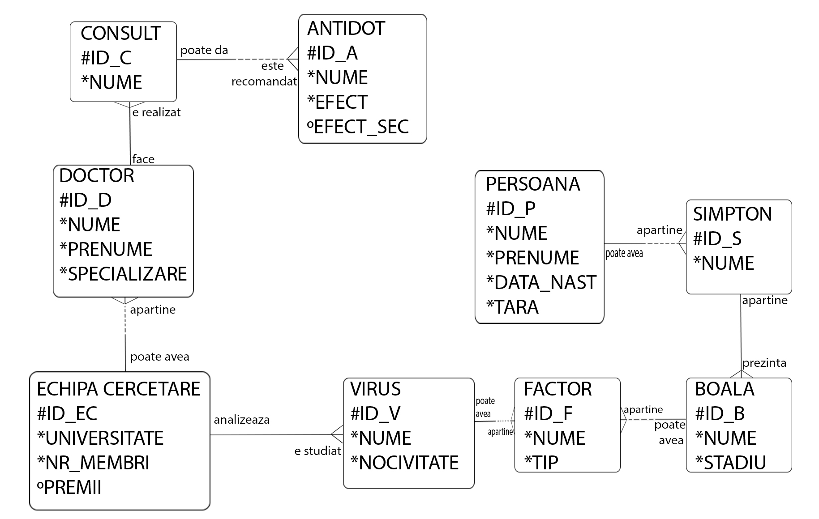
CONCEPTUAL DIAGRAM

Slide 4
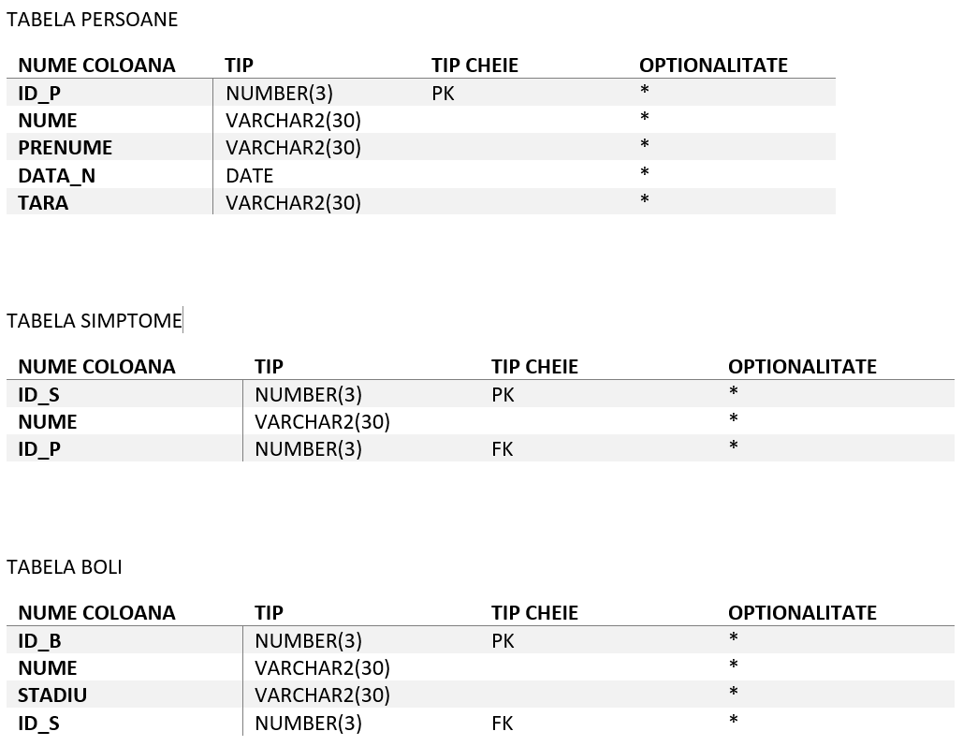
MAPPING RELATIONSHIPS

Slide 5
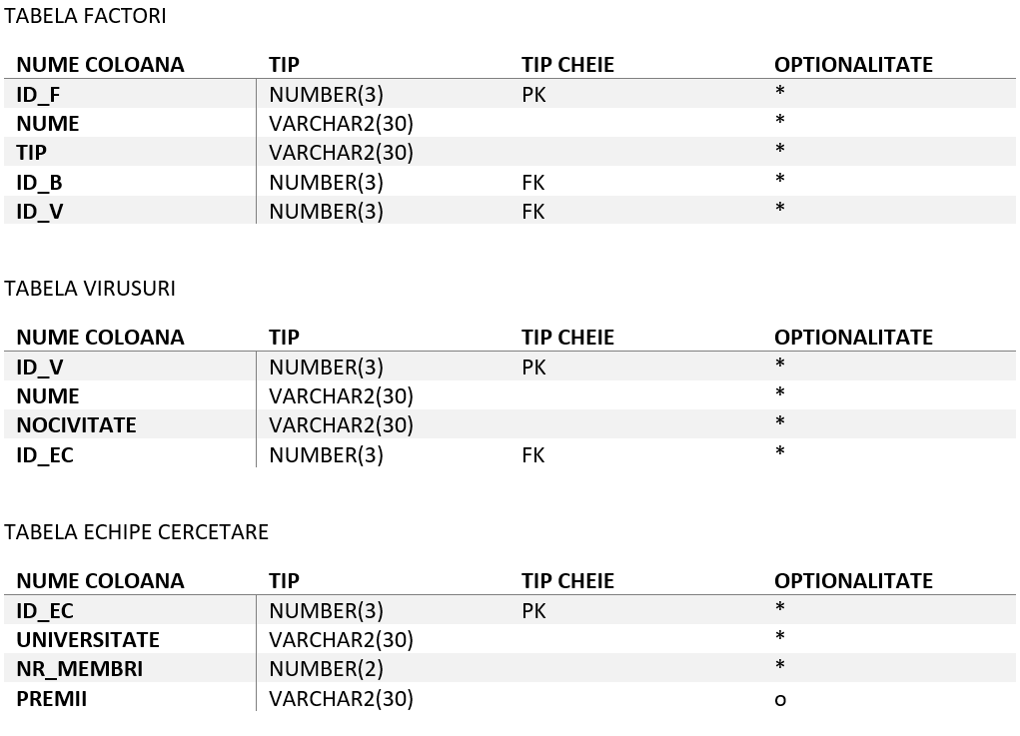

Slide 6
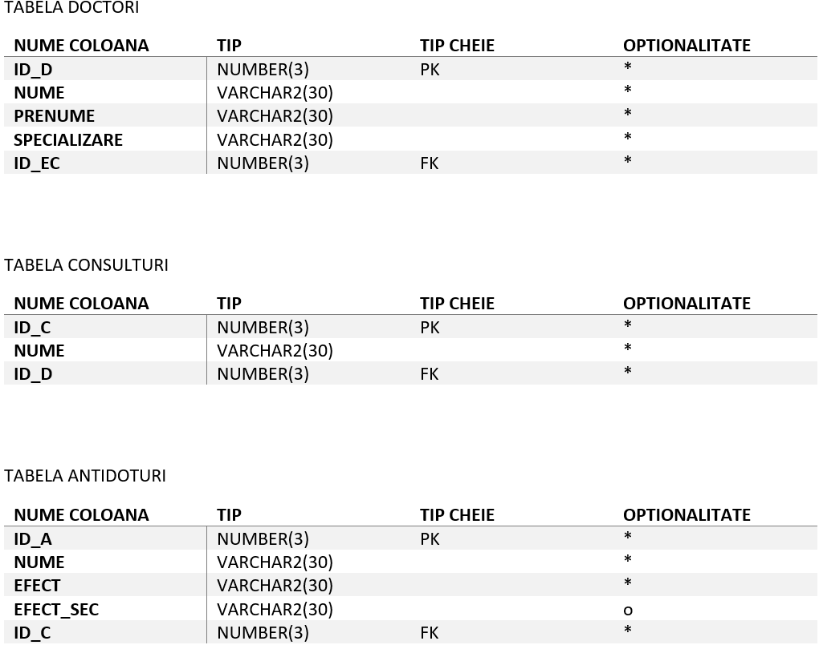

Slide 7
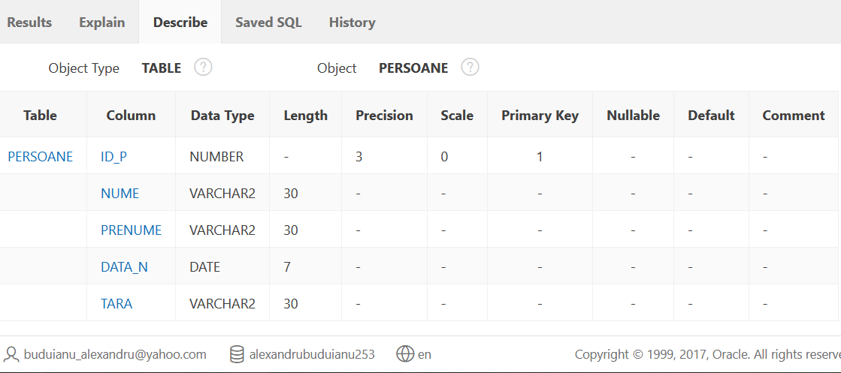
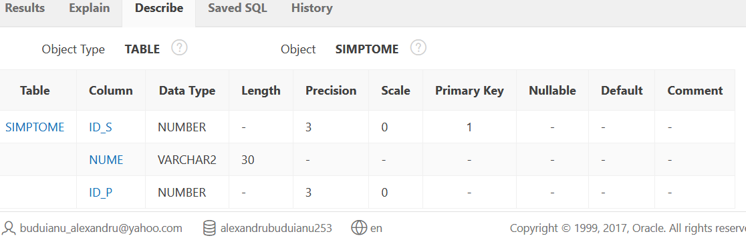
CREATING TABLES
TABELA PERSOANE
create table persoane (
id_p NUMBER(3) NOT NULL,
nume varchar2(30) NOT NULL,
prenume varchar2(30) NOT NULL,
data_n date NOT NULL,
tara varchar2(30) NOT NULL,
constraint "persoane_pk" PRIMARY KEY (id_p) ) ;
TABELA SIMPTOME
create table simptome (
id_s NUMBER(3) NOT NULL,
nume varchar2(30) NOT NULL,
id_p NUMBER(3) NOT NULL,
constraint "simptome_pk" PRIMARY KEY (id_s),
CONSTRAINT "simptome_fk" FOREIGN KEY (id_p) REFERENCES persoane (id_p));

Slide 8
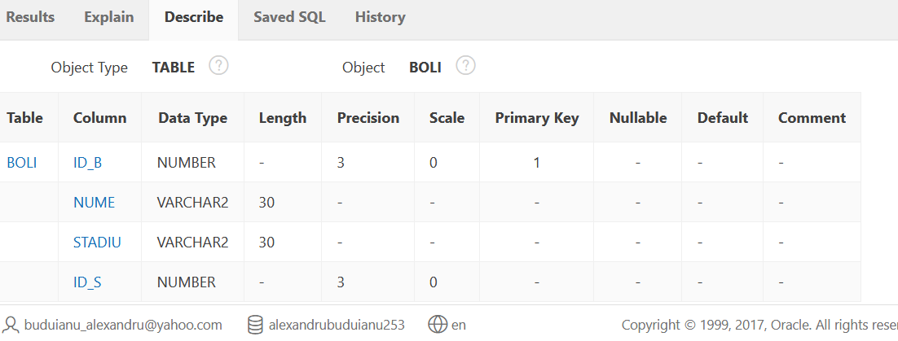
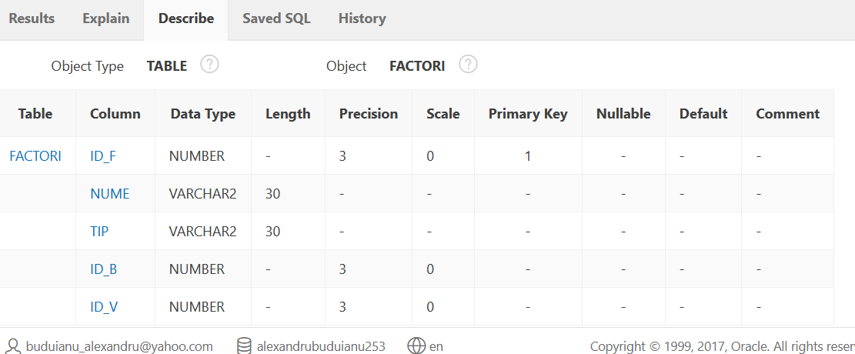
TABELA BOLI
create table boli(
id_b NUMBER(3) NOT NULL,
nume varchar2(30) NOT NULL,
stadiu varchar2(30) NOT NULL,
id_s NUMBER(3) NOT NULL,
constraint "boli_pk" PRIMARY KEY (id_b),
CONSTRAINT "boli_fk" FOREIGN KEY (id_s) REFERENCES simptome (id_s));
TABELA FACTORI
create table factori(
id_f NUMBER(3) NOT NULL,
nume varchar2(30) NOT NULL,
tip varchar2(30) NOT NULL,
id_b NUMBER(3) NOT NULL,
id_v NUMBER(3) NOT NULL,
constraint "factori_pk" PRIMARY KEY (id_f),
CONSTRAINT "factori_fk" FOREIGN KEY (id_b) REFERENCES boli (id_b),
CONSTRAINT "factori.fk" FOREIGN KEY (id_v) REFERENCES virusi (id_v));

Slide 9
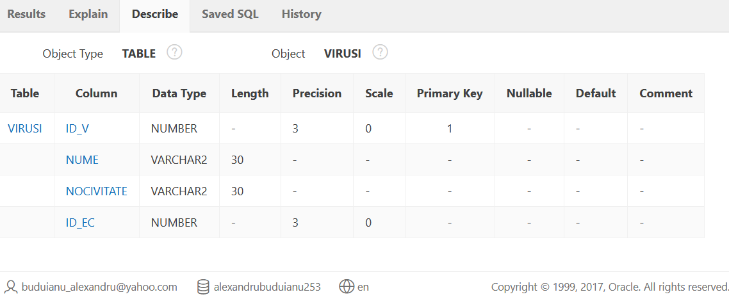
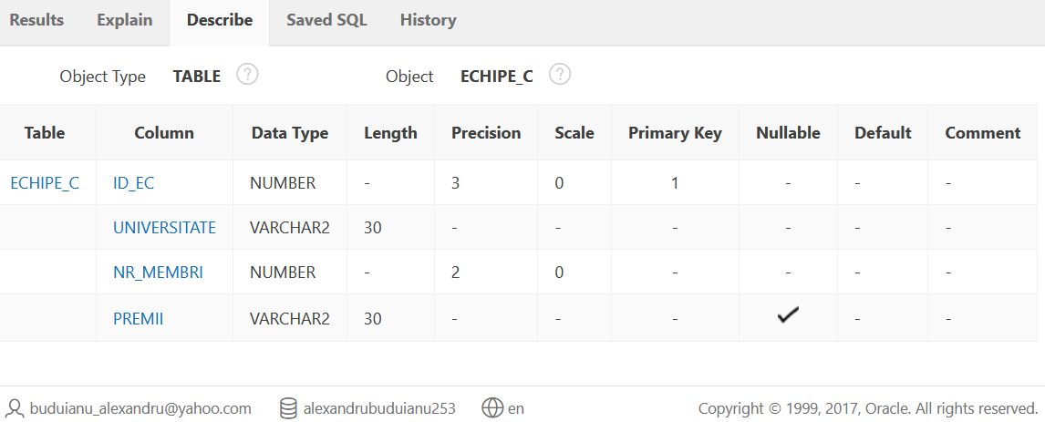
TABELA VIRUSURI
create table virusi(
id_v NUMBER(3) NOT NULL,
nume varchar2(30) NOT NULL,
nocivitate varchar2(30) NOT NULL,
id_ec NUMBER(3) NOT NULL,
constraint "virusi_pk" PRIMARY KEY (id_v) ,
constraint "virusi_fk" FOREIGN KEY (id_ec) REFERENCES echipe_c (id_ec) );
TABELA ECHIPE CERCETARE
create table echipe_c(
id_ec NUMBER(3) NOT NULL,
universitate varchar2(30) NOT NULL,
nr_membri NUMBER(2) NOT NULL,
premii varchar2(30),
constraint "echipe_c_pk" PRIMARY KEY (id_ec) );

Slide 10
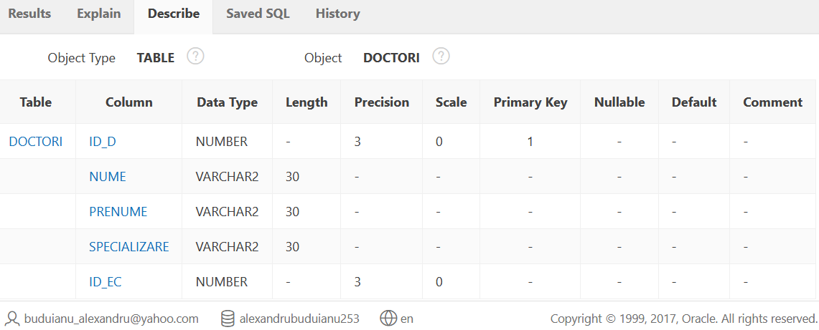
TABELA DOCTORI
create table doctori(
id_d NUMBER(3) NOT NULL,
nume varchar2(30) NOT NULL,
prenume varchar2(30) NOT NULL,
specializare varchar2(30) NOT NULL,
id_ec NUMBER(3) NOT NULL,
constraint "doctori_pk" PRIMARY KEY (id_d) ,
constraint "doctori_fk" FOREIGN KEY (id_ec) REFERENCES echipe_c (id_ec) );

Slide 11
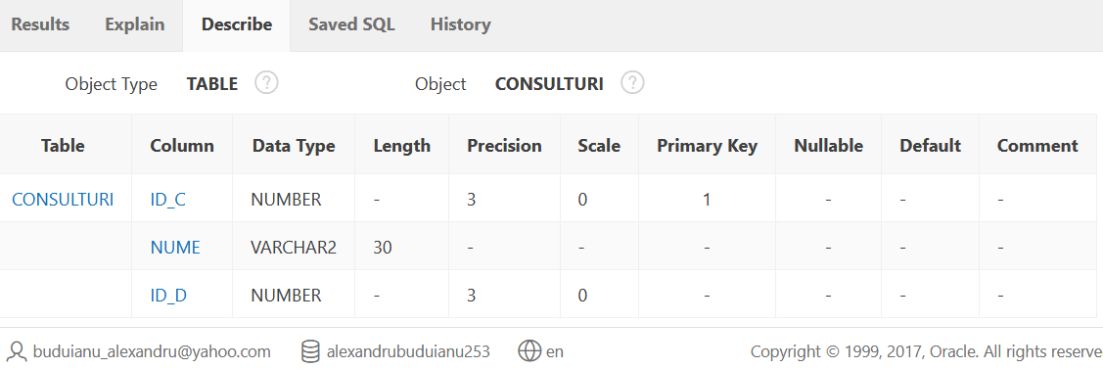
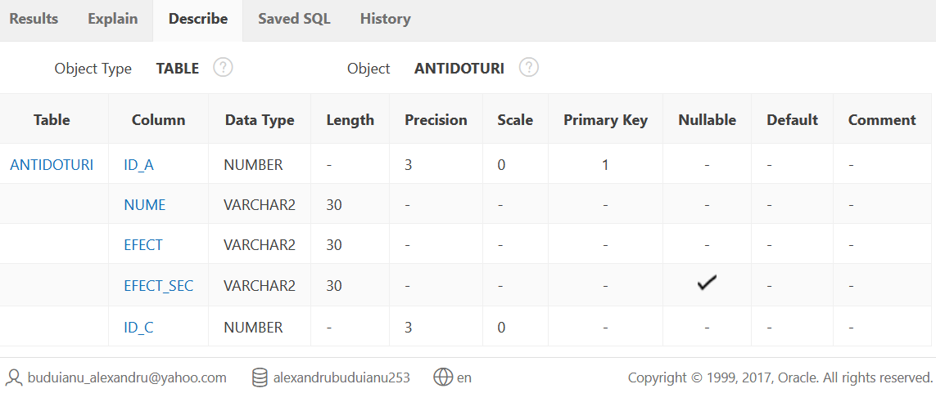
TABELA CONSULTURI
create table consulturi(
id_c NUMBER(3) NOT NULL,
nume varchar2(30) NOT NULL,
id_d NUMBER(3) NOT NULL,
constraint "cons_pk" PRIMARY KEY (id_c) ,
constraint "cons_fk" FOREIGN KEY (id_d) REFERENCES doctori(id_d) );
TABELA ANTIDOTURI
create table antidoturi(
id_a NUMBER(3) NOT NULL,
nume varchar2(30) NOT NULL,
efect varchar2(30) NOT NULL,
efect_sec varchar2(30),
id_c NUMBER(3) NOT NULL,
constraint "anti_pk" PRIMARY KEY (id_a) ,
constraint "anti_fk" FOREIGN KEY (id_c) REFERENCES consulturi(id_c) );

Slide 12
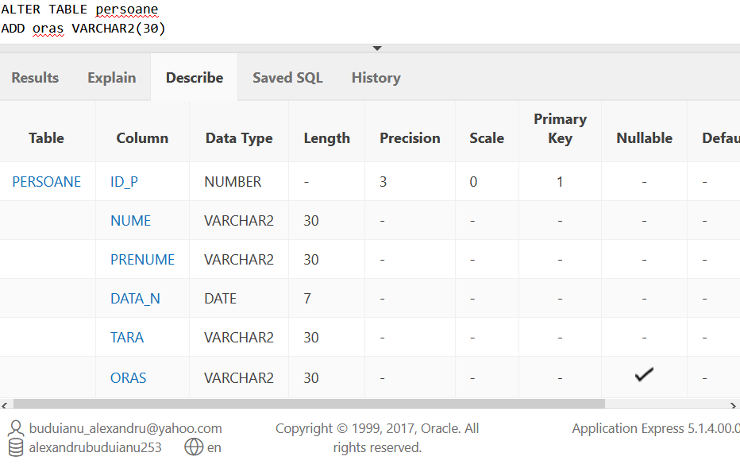
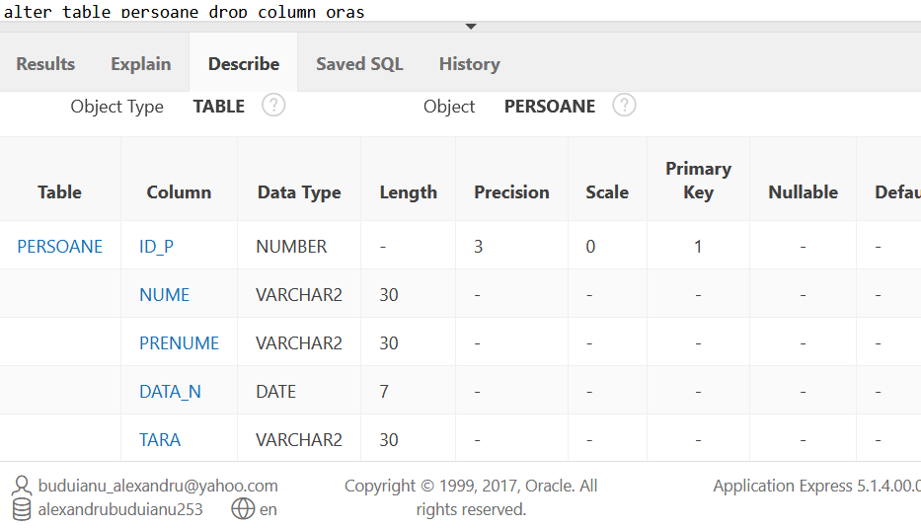
UPDATING TABLE STRUCTURE
ALTER TABLE persoane
ADD oras VARCHAR2(30);
alter table persoane drop column oras;

Slide 13
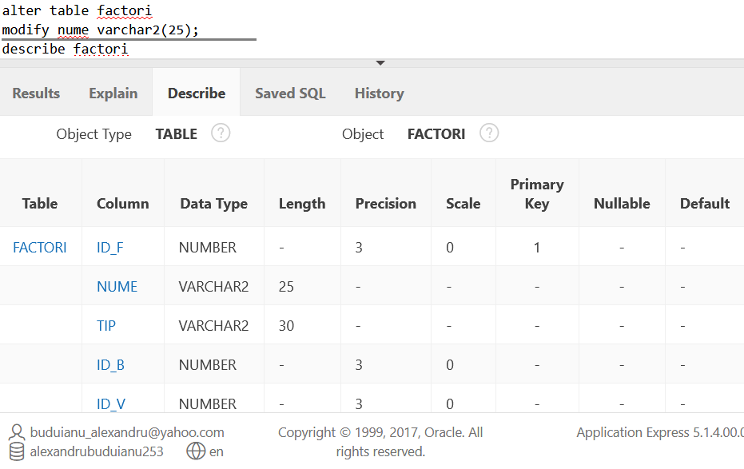
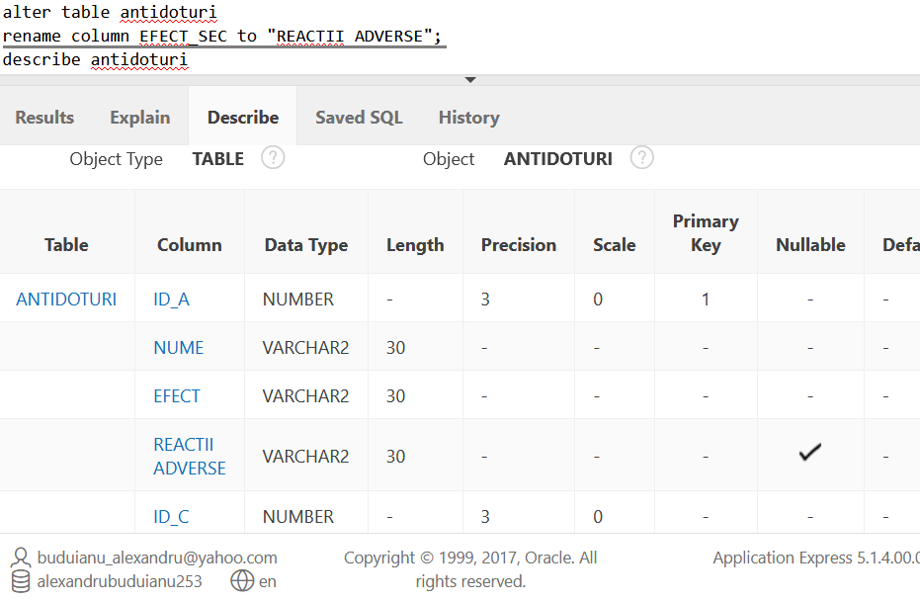
alter table factori
modify nume varchar2(25)
alter table antidoturi
rename column EFECT_SEC to "REACTII ADVERSE";

Slide 14
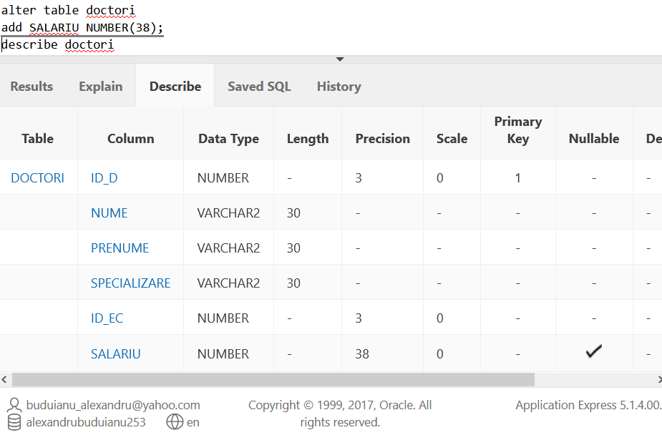
alter table doctori
add SALARIU NUMBER(38);

Slide 15
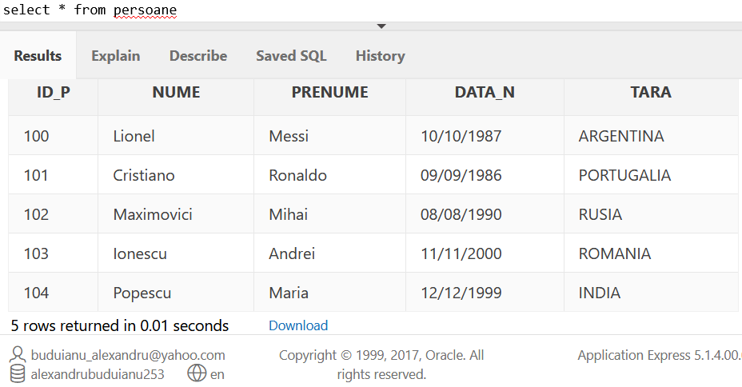
ADDING RECORDS TO TABLES
TABELA PERSOANE
INSERT INTO persoane VALUES
('100','Lionel','Messi','10/10/1987','ARGENTINA'),
('101','Cristiano','Ronaldo','09/09/1986','PORTUGALIA'),
('102','Maximovici','Mihai','08/08/1990','RUSIA'),
('103','Ionescu','Andrei','11/11/2000','ROMANIA'),
('104','Popescu','Maria','12/12/1999','INDIA');

Slide 16
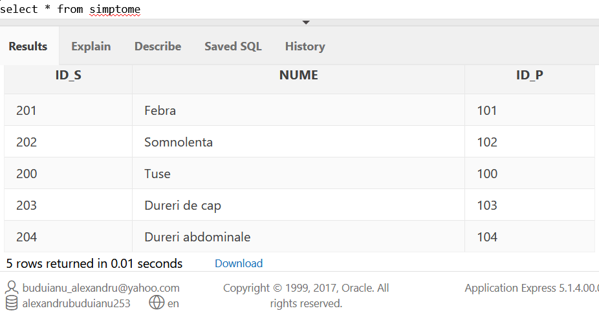
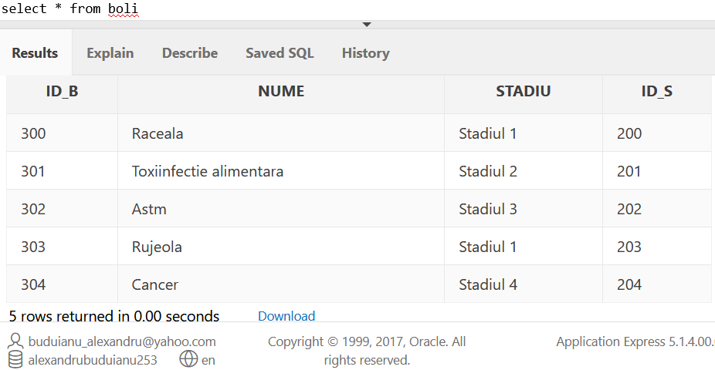
TABELA SIMPTOME
INSERT INTO simptome VALUES
('200','Tuse', '100')
('201','Febra', '101')
('202','Somnolenta', '102')
('203','Dureri de cap', '103')
('204','Dureri abdominale', '104');
TABELA BOLI
INSERT INTO boli VALUES
('300','Raceala','Stadiul 1', '200')
('301','Toxiinfectie alimentara','Stadiul 2', '201')
('302','Astm','Stadiul 3', '202')
('302','Rujeola','Stadiul 3', '202')
('304','Cancer','Stadiul 4', '204');

Slide 17
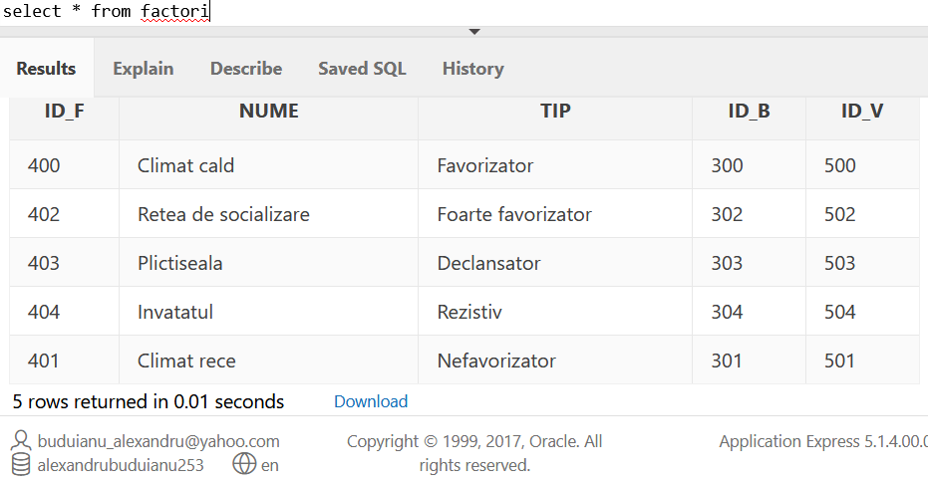
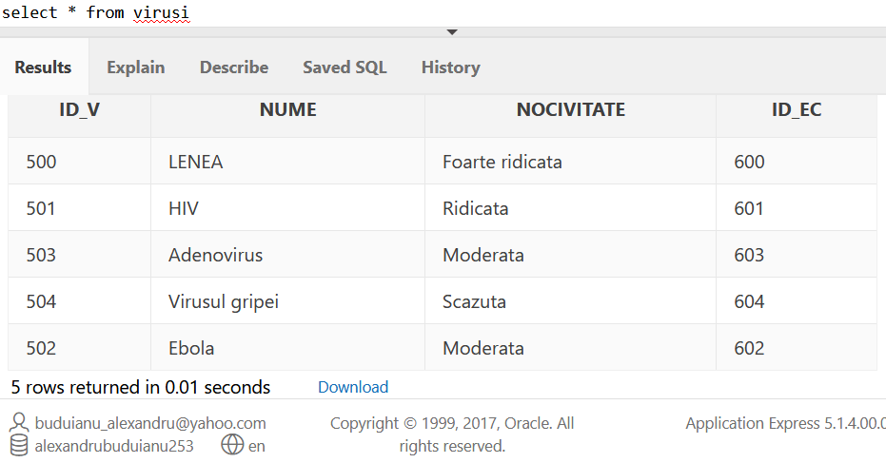
TABELA FACTORI
INSERT INTO factori VALUES
('400','Climat cald','Favorizator','300','500')
('401','Climat rece','Nefavorizator','301','501')
('402','Retea de socializare','Foarte favorizator','302','502')
('403','Plictiseala','Declansator','303','503')
('404','Invatatul','Rezistiv','304','504');
TABELA VIRUSURI
('500','LENEA','Foarte ridicata','600')
('501','HIV','Ridicata','601')
('502','Ebola','Moderata','602')
('503','Adenovirus','Moderata','603')
('504','Virusul gripei','Scazuta','604');

Slide 18
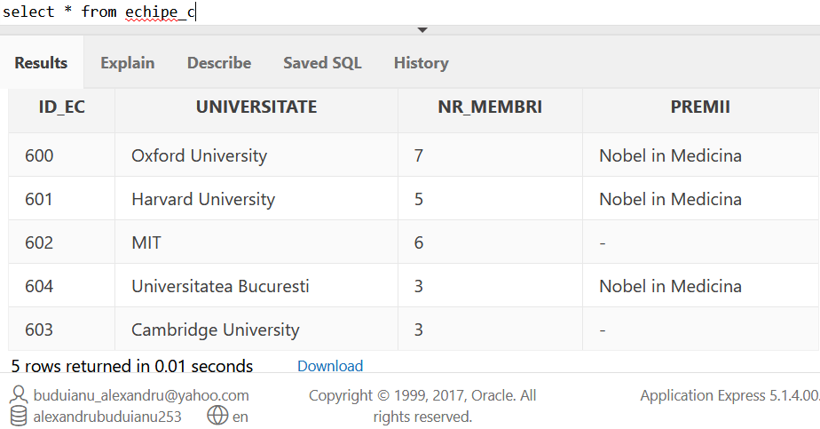
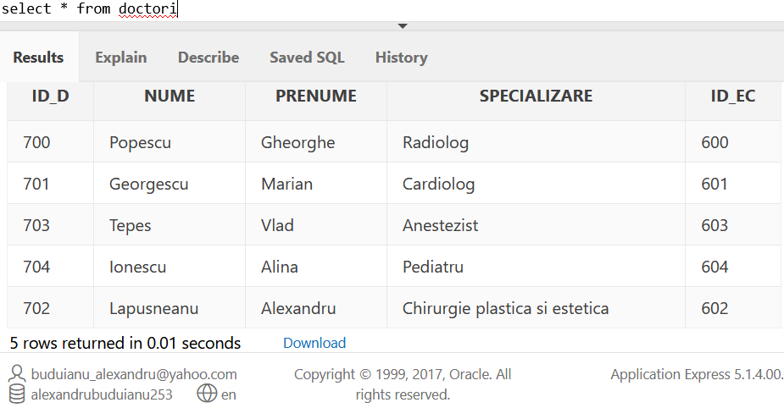
ECHIPE CERCETARE
INSERT INTO echipe_c VALUES
('600','Oxford University','7', 'Nobel in Medicina')
('601','Harvard University','5', 'Nobel in Medicina')
('602','MIT','6','')
('603','Cambridge University','3','')
('604','Universitatea Bucuresti','3','Nobel in Medicina');
DOCTORI
INSERT INTO doctori VALUES
('700','Popescu','Gheorghe','Radiolog','600')
('701','Georgescu','Marian','Cardiolog','601')
('702','Lapusneanu','Alexandru','Chirurgie plastica si estetica','602')
('703','Tepes','Vlad','Anestezist','603')
('704','Ionescu','Alina','Pediatru','604');

Slide 19
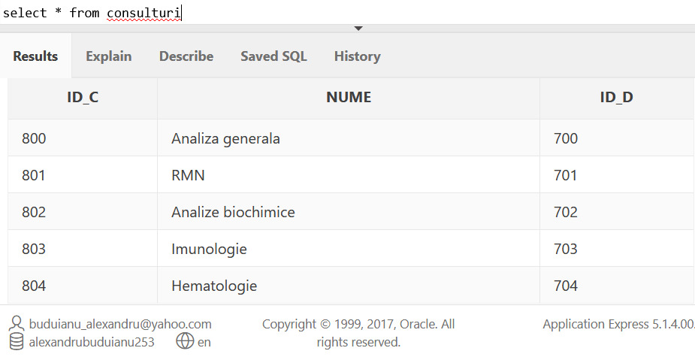
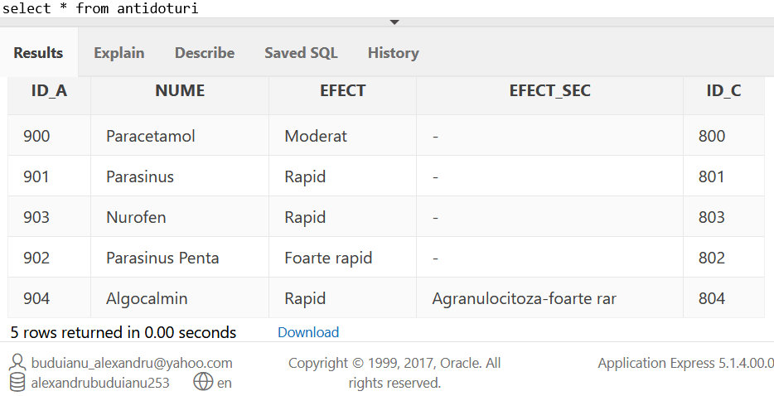
CONSULTURI
INSERT INTO consulturi VALUES
('800','Analiza generala','700')
('801','RMN','701')
('802','Analize biochimice','702')
('803','Imunologie','703')
('804','Hematologie','704');
ANTIDOTURI
('900','Paracetamol','Moderat','','800')
('901','Parasinus','Rapid','','801')
('902','Parasinus Penta','Foarte rapid','','802')
('903','Nurofen','Rapid','','803')
('904','Algocalmin','Rapid','Agranulocitoza-foarte rar','804');

Slide 20
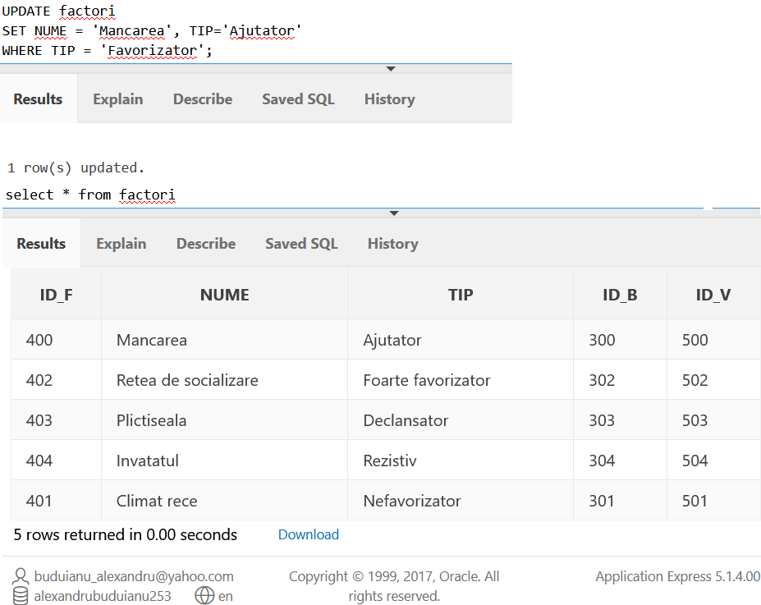
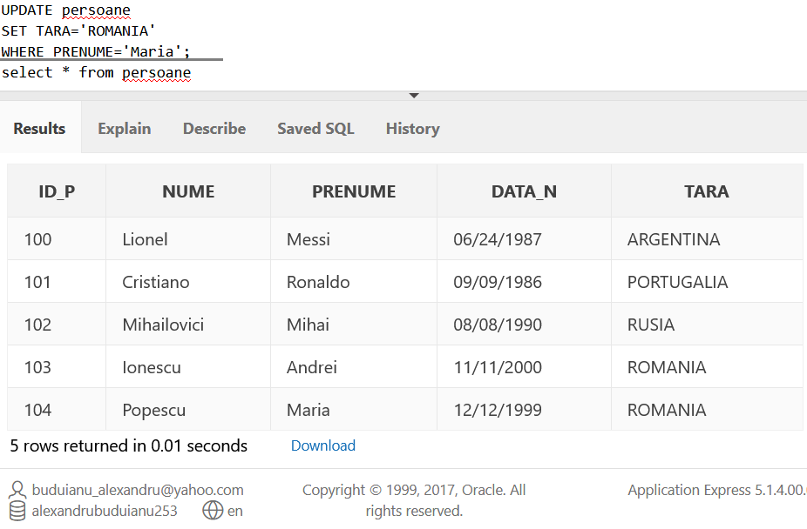
MODIFYING DATA(update)
UPDATE factori
SET NUME = 'Mancarea', TIP='Ajutator'
WHERE TIP = 'Favorizator';
UPDATE persoane
SET TARA='ROMANIA’
WHERE PRENUME='Maria';

Slide 21
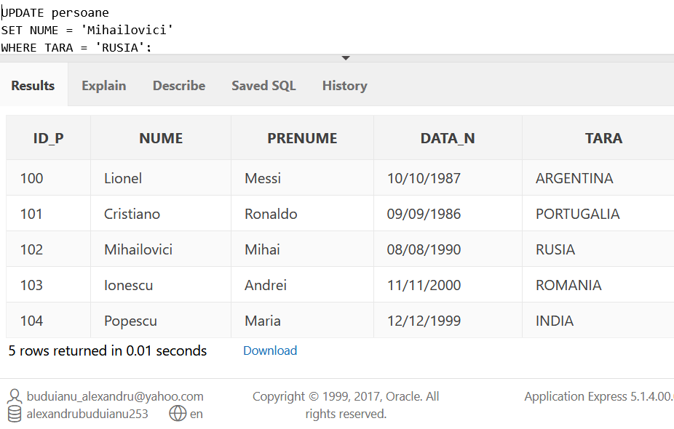
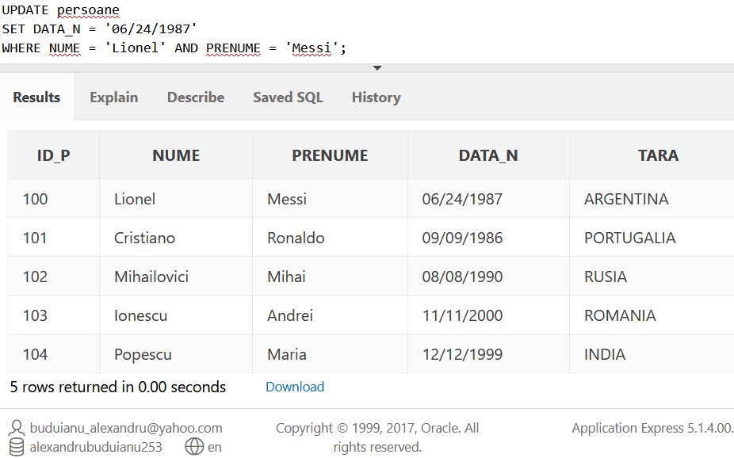
UPDATE persoane
SET NUME = 'Mihailovici’
WHERE TARA = 'RUSIA';
UPDATE persoane
SET DATA_N = '06/24/1987'
WHERE NUME = 'Lionel' AND PRENUME = 'Messi';

Slide 22
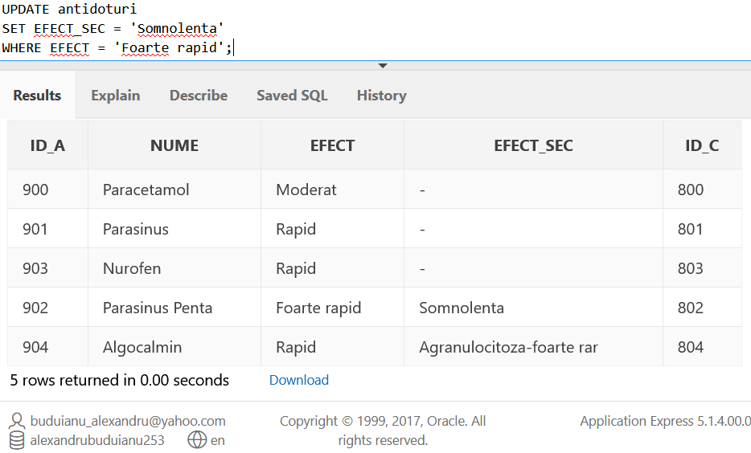
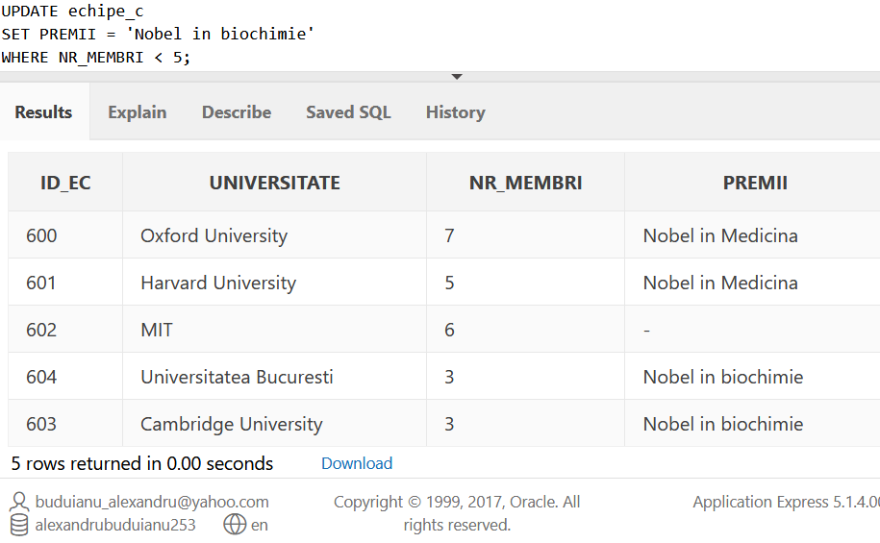
UPDATE antidoturi
SET EFECT_SEC = 'Somnolenta'
WHERE EFECT = 'Foarte rapid';
UPDATE echipe_c
SET PREMII = 'Nobel in biochimie’
WHERE NR_MEMBRI < 5;

Slide 23
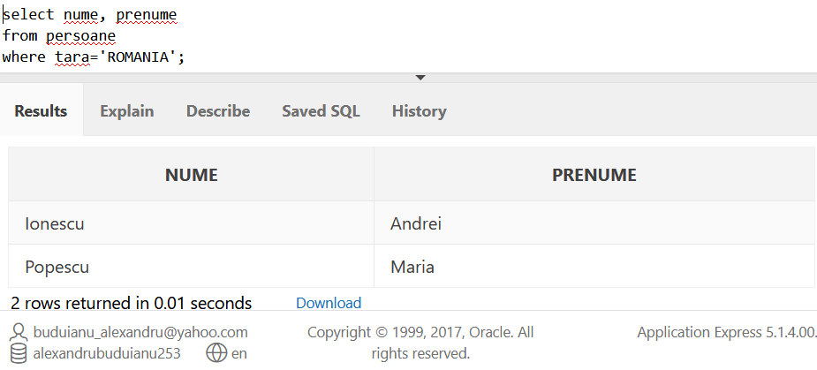
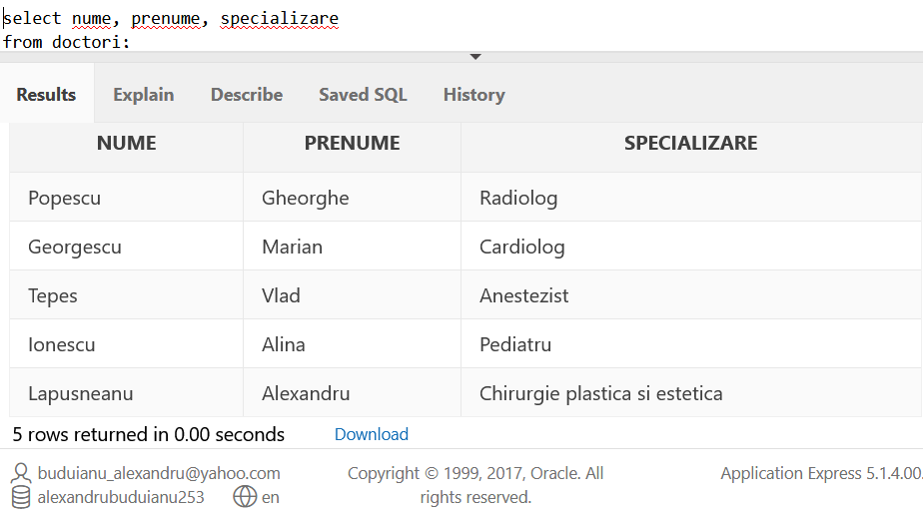
EXAMPLES OF VARIED QUERIES
select nume, prenume
from persoane
where tara='ROMANIA';
select nume, prenume, specializare
from doctori;

Slide 24
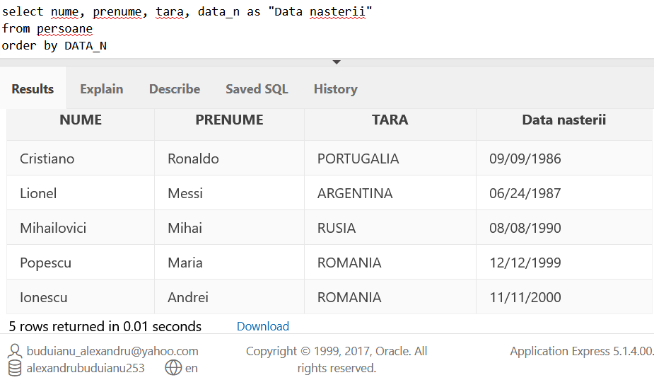
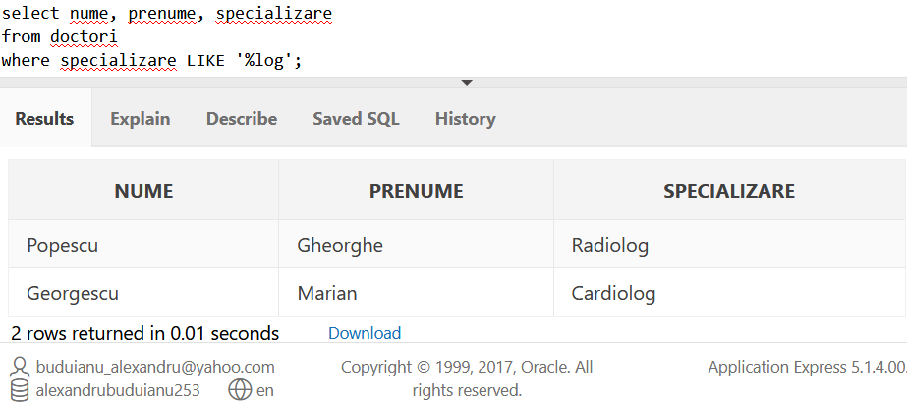
select nume, prenume, tara, data_n as "Data nasterii"
from persoane
order by DATA_N;
select nume, prenume, specializare
from doctori
where specializare LIKE '%log';

Slide 25
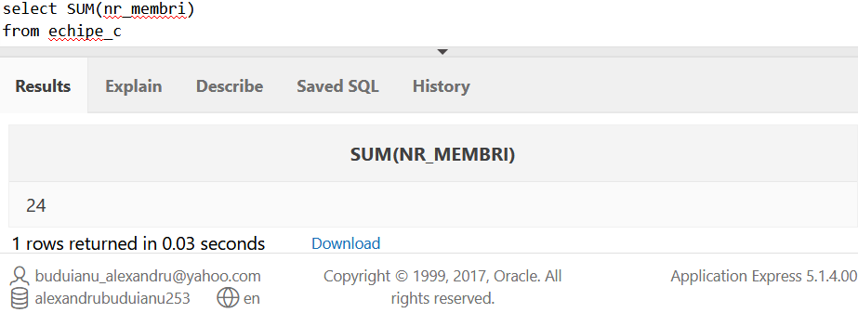
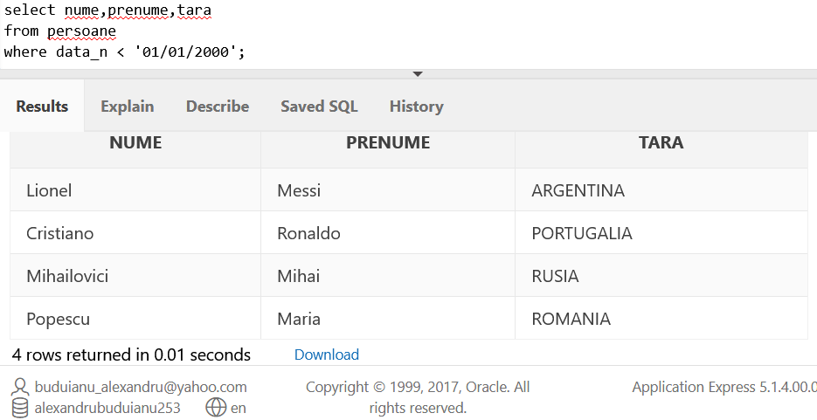
select SUM(nr_membri)
from echipe_c;
select nume,prenume,tara
from persoane
where data_n < '01/01/2000';

Slide 26
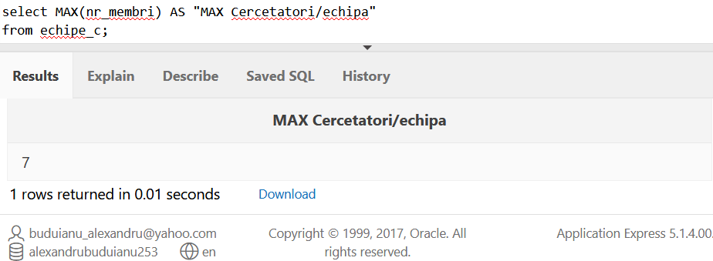
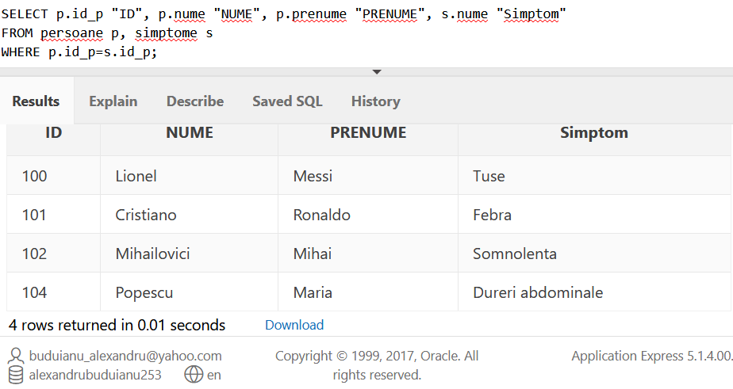
select MAX(nr_membri) AS "MAX Cercetatori/echipa"
from echipe_c;
SELECT p.id_p "ID", p.nume "NUME", p.prenume "PRENUME", s.nume "Simptom"
FROM persoane p, simptome s
WHERE p.id_p=s.id_p;

Slide 27
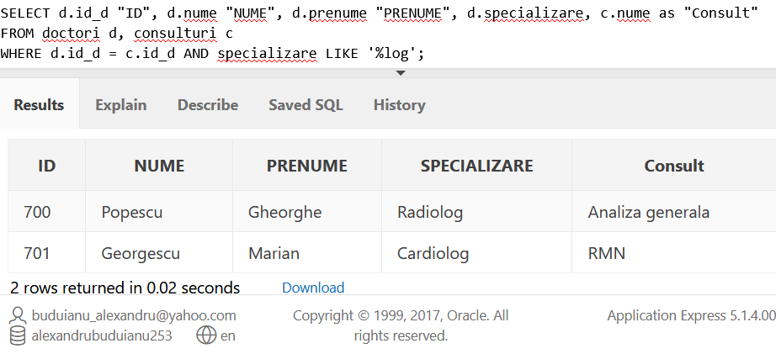
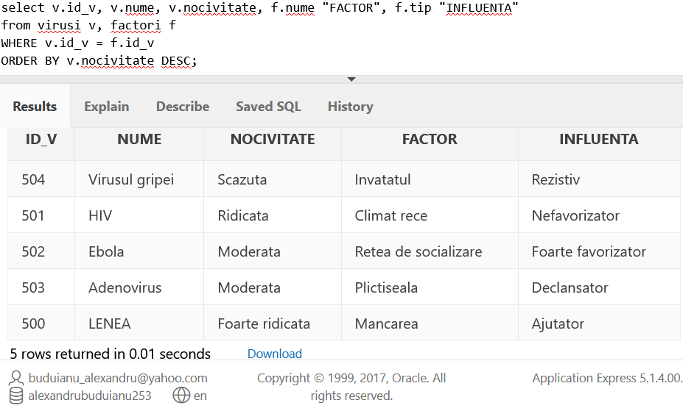
SELECT d.id_d "ID", d.nume "NUME", d.prenume "PRENUME", d.specializare, c.nume as "Consult"
FROM doctori d, consulturi c
WHERE d.id_d = c.id_d AND specializare LIKE '%log';
select v.id_v, v.nume, v.nocivitate, f.nume "FACTOR", f.tip "INFLUENTA"
from virusi v, factori f
WHERE v.id_v = f.id_v
ORDER BY v.nocivitate DESC;

Slide 28
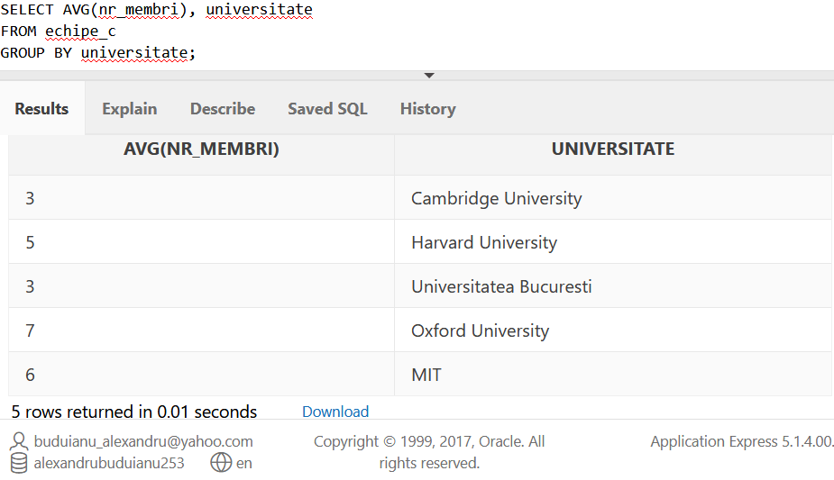
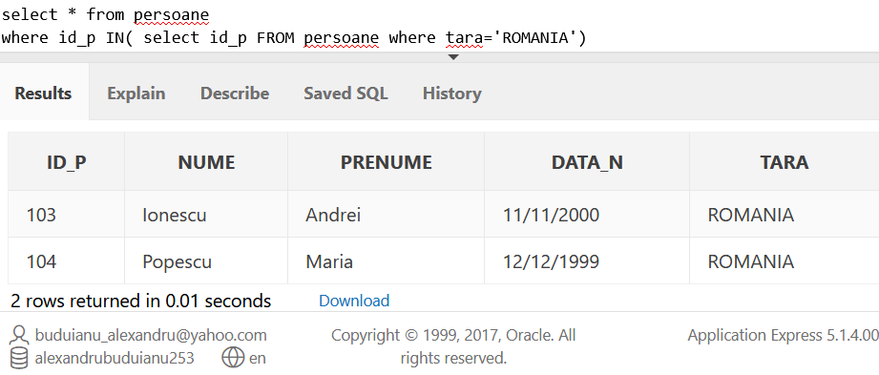
SELECT AVG(nr_membri), universitate
FROM echipe_c
GROUP BY universitate;
select * from persoane
where id_p IN( select id_p
FROM persoane
where tara='ROMANIA');

Slide 29
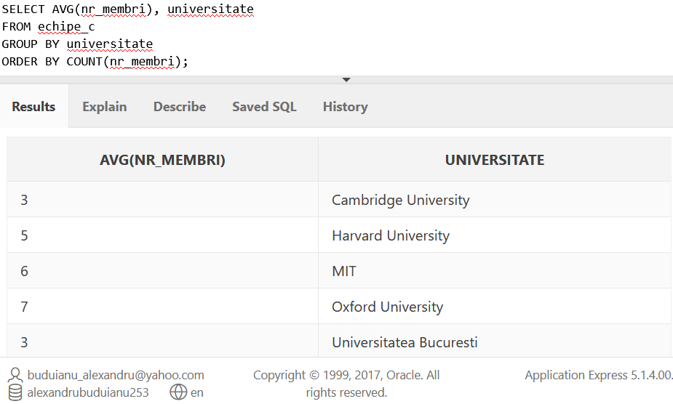
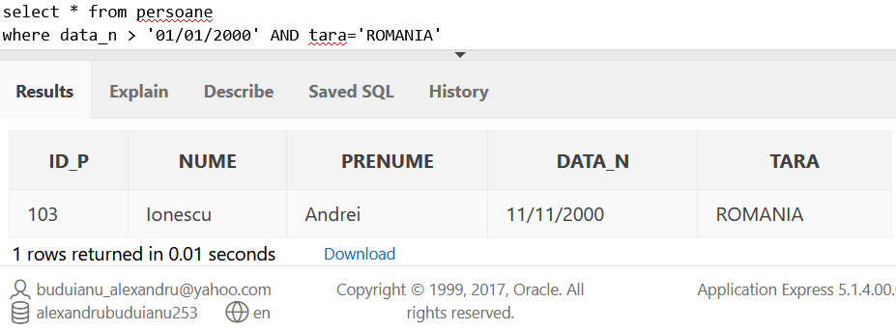
SELECT AVG(nr_membri), universitate
FROM echipe_c
GROUP BY universitate
ORDER BY COUNT(nr_membri);
select *from persoane
where data_n > '01/01/2000’
AND tara='ROMANIA';

Slide 30
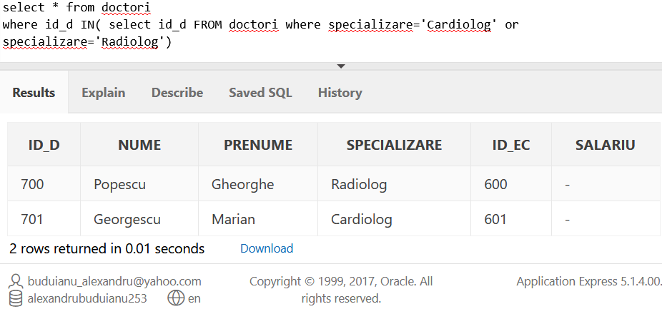
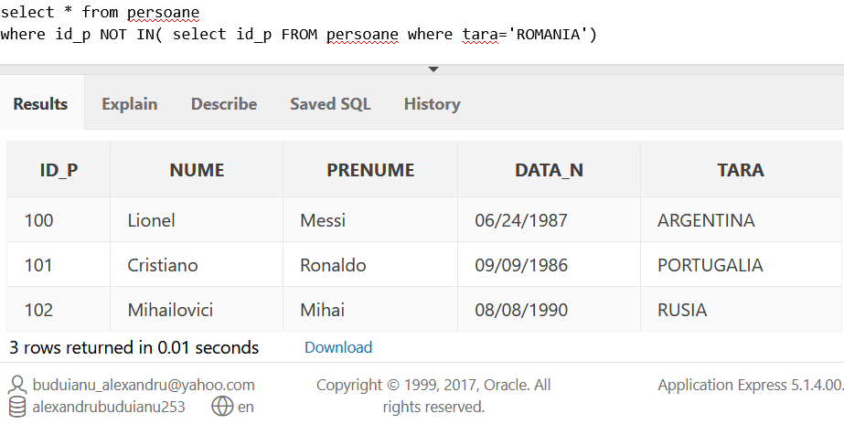
select * from doctori
where id_d IN( select id_d
FROM doctori
where specializare='Cardiolog' or specializare='Radiolog')
select * from persoane
where id_p NOT IN( select id_p
FROM persoane
where tara='ROMANIA')

